Slide 1

Ketch
Beaton / Butler / Carder / Greeson

Slide 2
Approach
Problem?
Existing peer-to-peer, buying and selling services are unsafe and insecure.
Solution
Identity validation
Secure transactions
Risks
Underestimating time required for primary requirements
Properly differentiating ourselves from competitors

Slide 3
Primary Requirements
Functional
Accept or deny current item offers
Message between user and buyer
Show items based upon location
Customer support functionality
Edit account information
Feedback/support system
Create and sell an item
Upload pictures
User Interface
Item listing (where the seller posts)
Facebook login page
Account information
Individual item view
Loading screen
Favorites page
Chat system
Dashboard

Slide 4
Primary Requirements
Usability
Will follow general iOS design philosophy
No unnecessary functionality or designs
Efficient and intuitive design
Simple to understand
Performance
Server must be able to handle consistent requests from many users
Database designed in an efficient manner
Mobile app must be lightweight

Slide 5
Primary Requirements
System Interface
Database talks to the mobile application and the website
Security
Payment system is done through Stripe
Facebook login to validate identities
Chat system is all done in-app
Only first names are given
User rating/report system

Slide 6
Secondary Requirements
Functional
Geolocation for safe areas to meet
Highly functional website
Refined search system
UI customization

Slide 7
Individual Subsystems

Slide 8
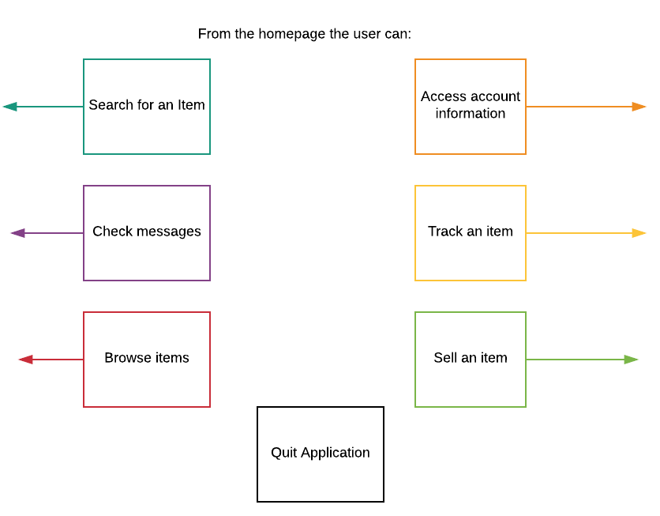
Homepage
Homepage

Slide 9
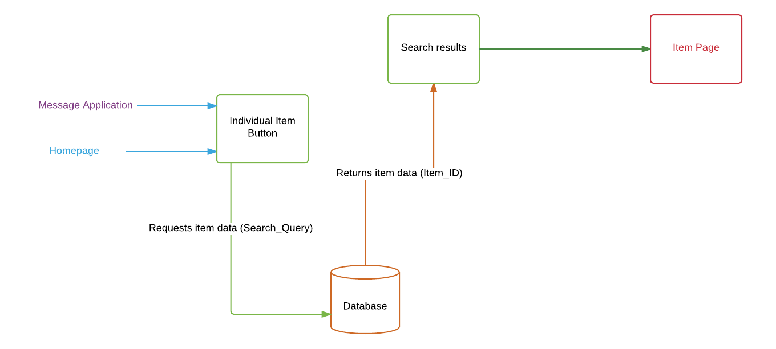
Homepage
Item Page

Slide 10
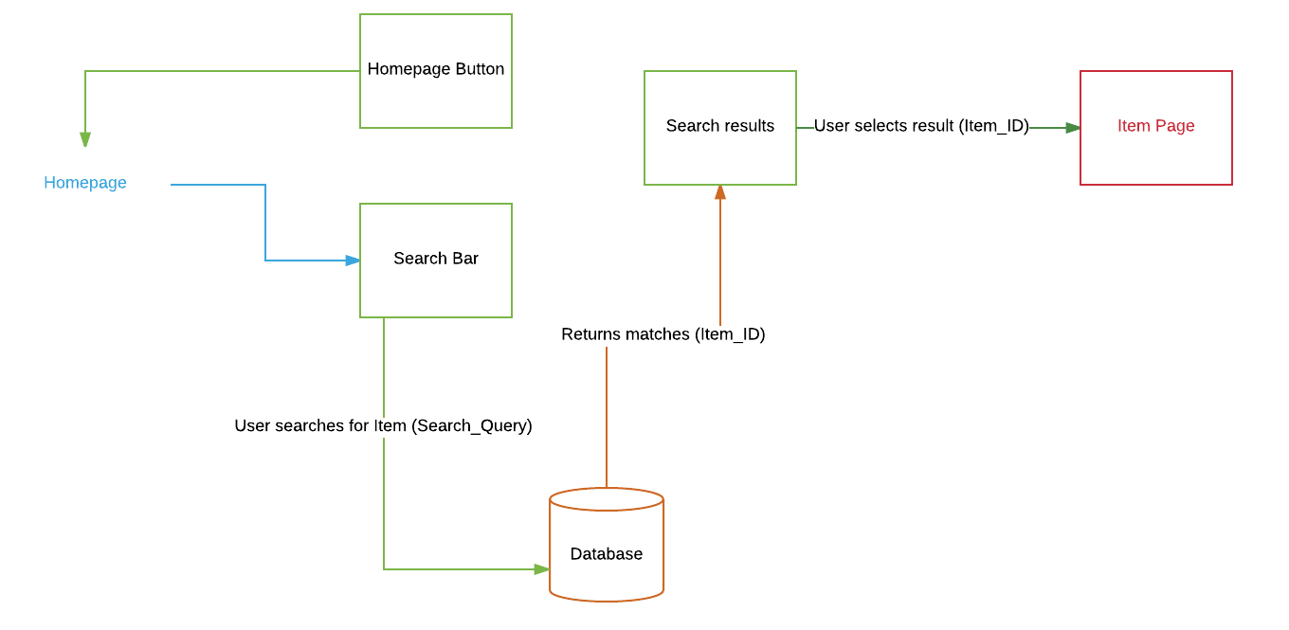
Homepage
Search Function

Slide 11
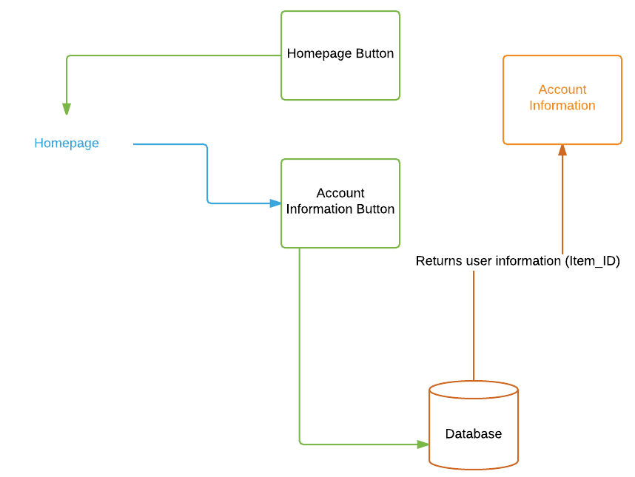
Homepage
Account Information

Slide 12
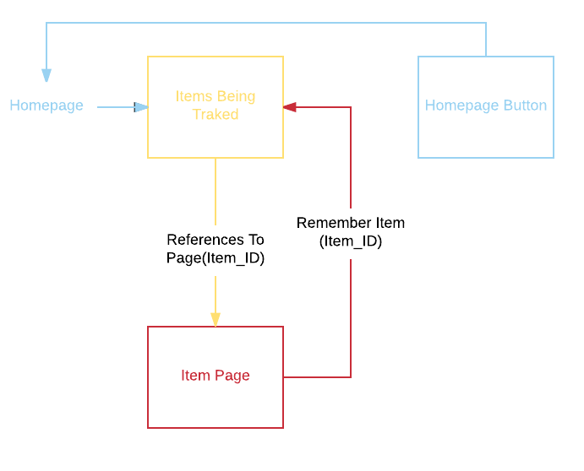
Homepage
Item Tracking

Slide 13
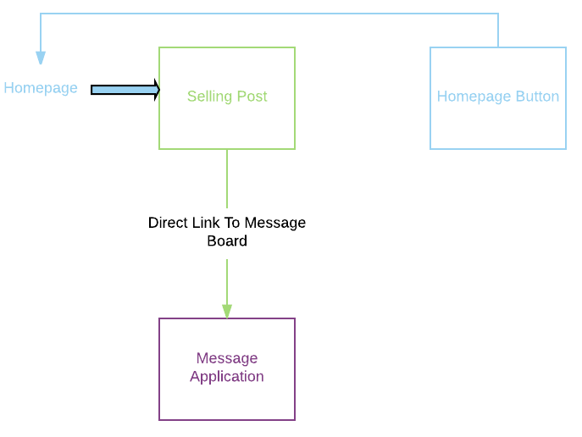
Homepage
Selling Post

Slide 14
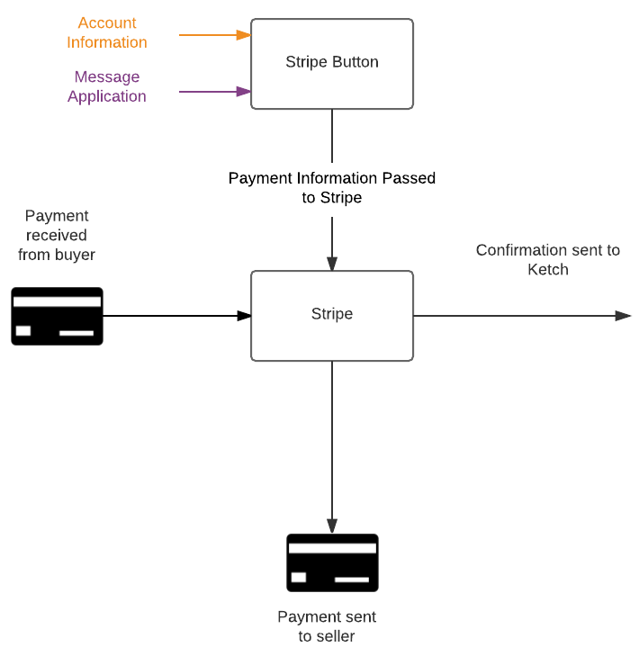
Homepage
Stripe

Slide 15
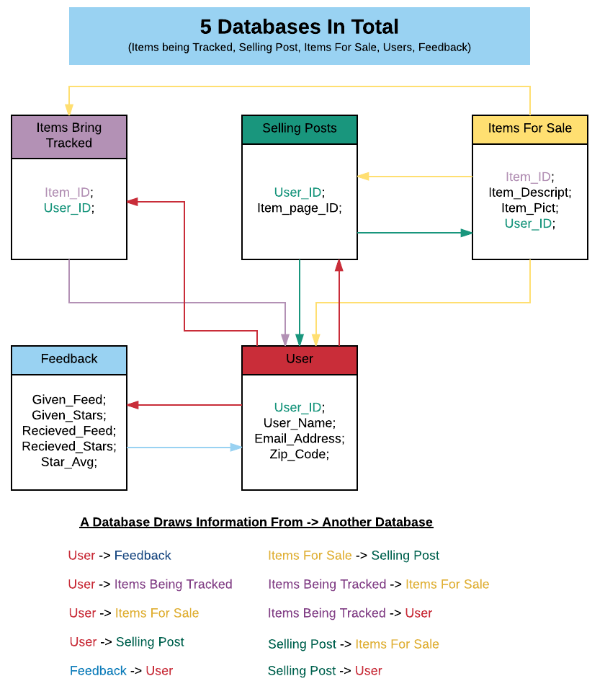
Homepage
Database Design

Slide 16
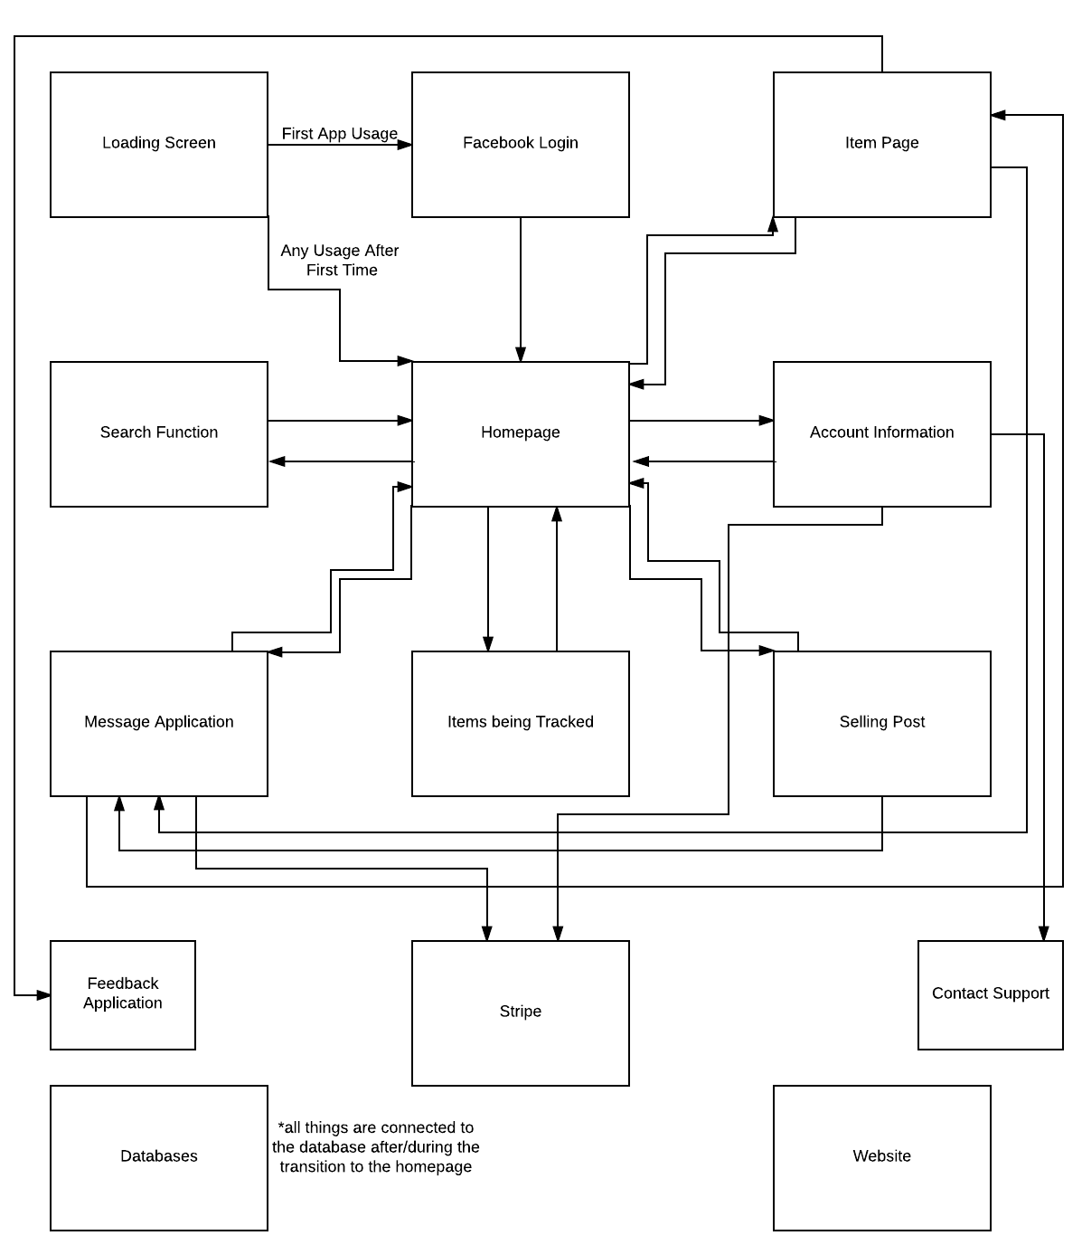
Entire System Design

Slide 17
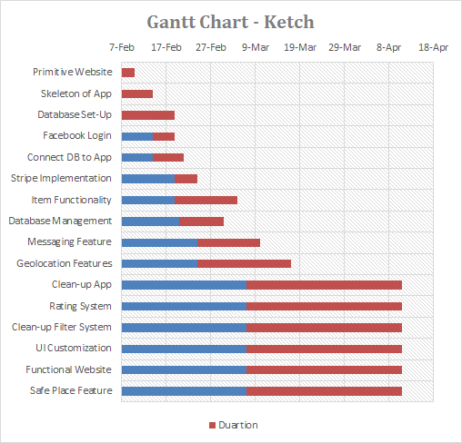
Timeline
09.05.XX
11.01.XX

Slide 18
Alternative Models
iOS ✔
Pros
We have access to iOS devices
Xcode is very intuitive/nice to use
Cons
We are not very familiar with Swift
iOS must be developed on a Mac environment
Requires a developer license to upload to the app store
Android
Pros
We are very comfortable with Java
Can be developed on Mac and Windows
Uploading to the Google Play store does not require a developer license
Cons
We do not have access to android devices
Android Studio is more confusing to use

Slide 19
Alternative Models
Username
Pros
More anonymity
Cons
Pseudonyms may be less secure due to less accountability
Real Name ✔
Pros
More accountability
Cons
Knowing someone’s name may violate user privacy

Slide 20
Alternative Models
Mobile ✔
Pros
Payments can be done in person once the item has been seen
Best suited for the average user
Cons
Users must have access to a WiFi or mobile network
Web
Pros
Easier for users to post items in bulk
Favors sellers who sell for a job
Cons
No way to access the information on the go unless you access the mobile website or bring a laptop

Slide 21
Alternative Models
Facebook login ✔
Pros
Users are verified
Increases accountability
Less data to keep track of
Cons
Some may not have Facebook
Some may not feel comfortable letting Facebook/Ketch having access to their info
Our own login system
Pros
We do not have to rely on the Facebook API
Users can change their info through our app
We can manage our own data
Cons
We cannot verify that the user is real

Slide 22
Who’s
doing
what?
Patrick:
Facebook API, Stripe API, Lead Programmer
Sawyer:
Geo Tracking, Documentation
Connor:
UI/UX, Search Functionality
Keaton:
Database Integration, UI

Slide 23
What’s next?
Implement a basic website
Setup skeleton of application
Database table setup

Slide 24
PART 2

Slide 25
Updated Project Report

Slide 26

What is Firebase?

Slide 27
Developing Capabilities
-Cloud Messaging
-Authentication
-Database
-Storage
-Hosting

Slide 28
Database-
Realtime Cloud Database
Remains responsive without network connectivity
Synchronizes when connectivity returns
Data stored in JSON tree
Data received as JSON object

Slide 29
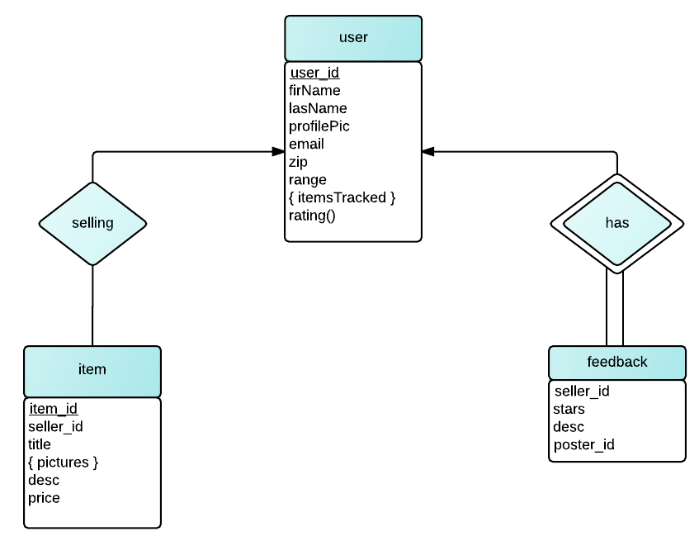
EER Diagram

Slide 30
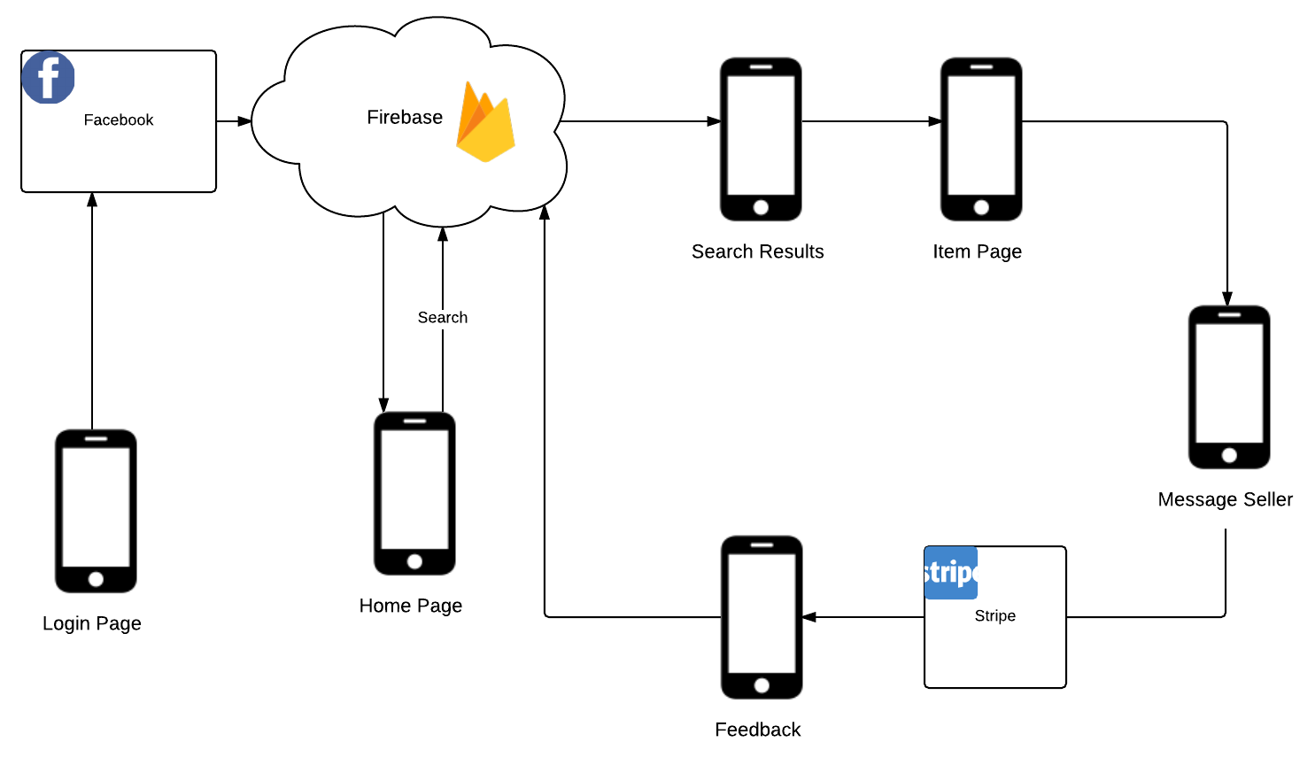
Typical User Interaction

Slide 31
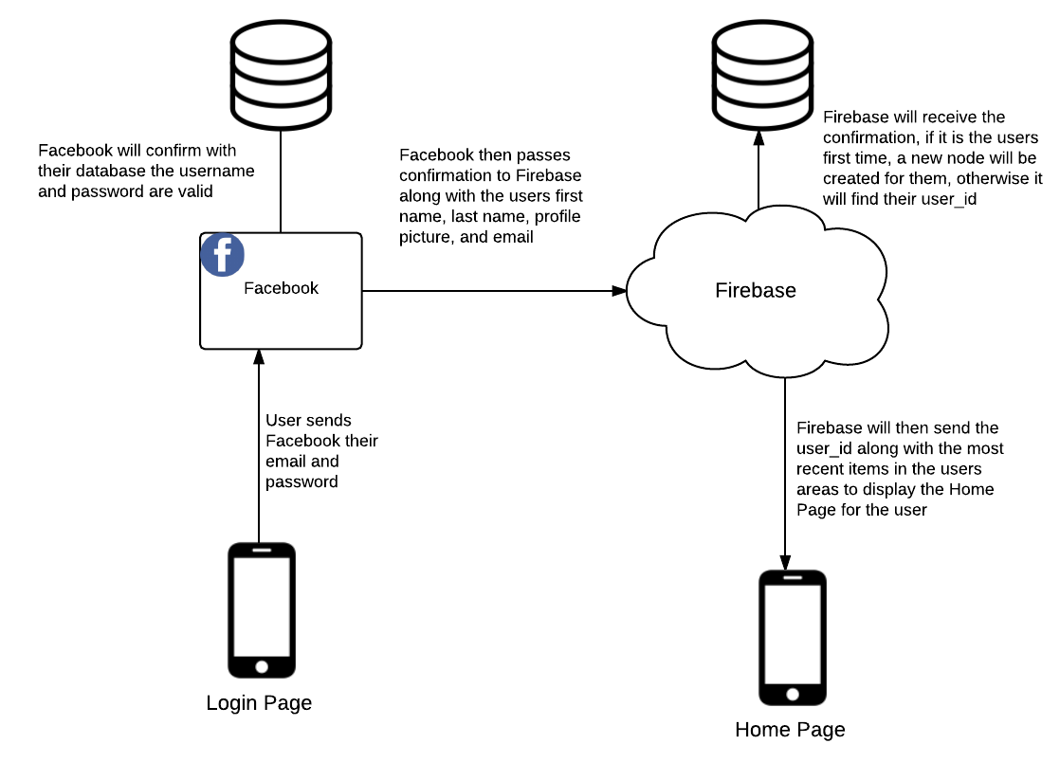
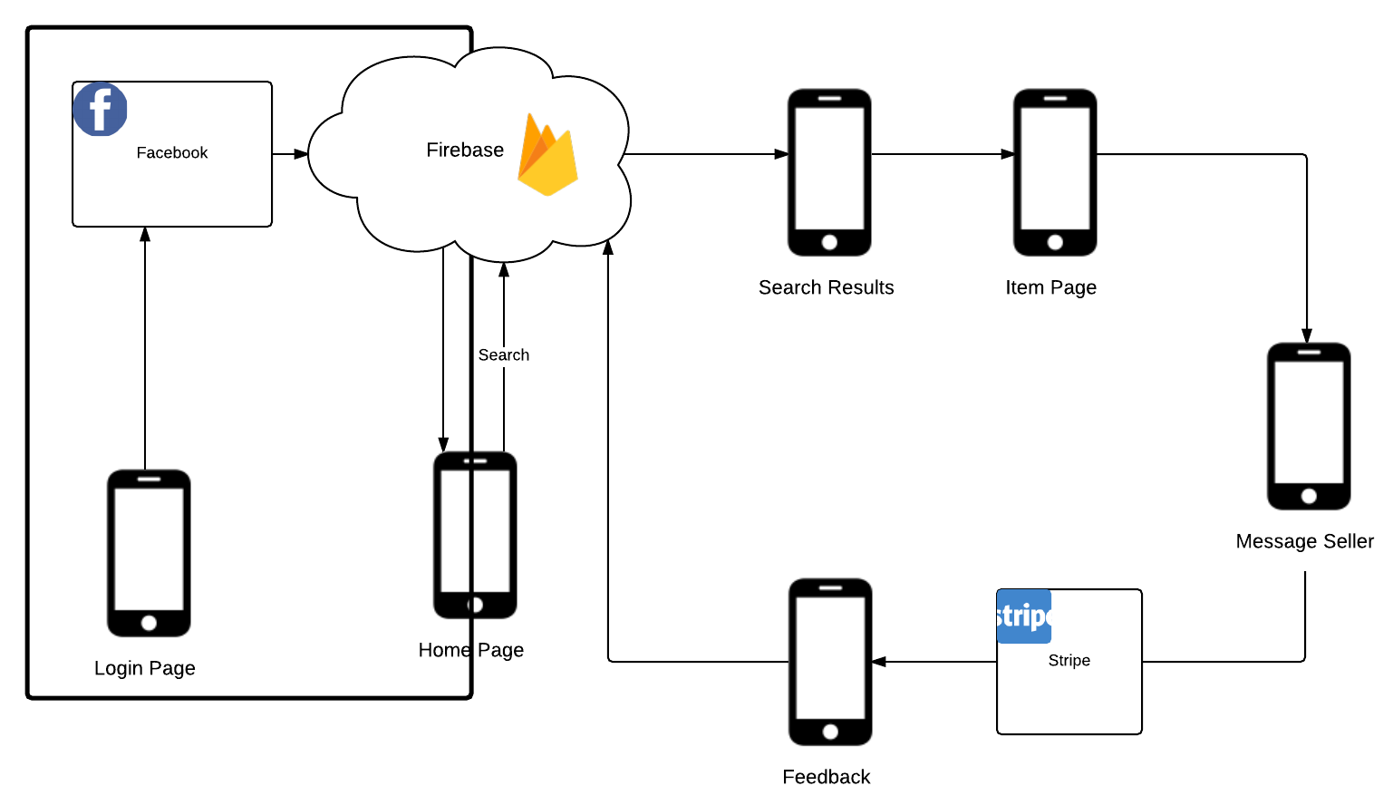
User Login/ Authentication

Slide 32
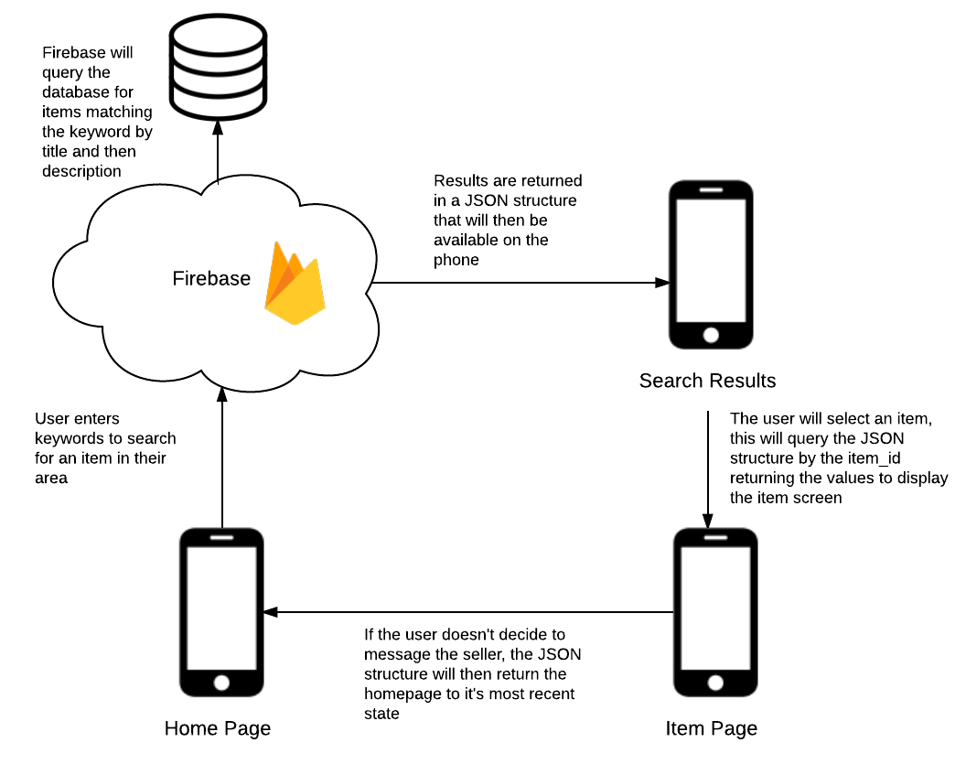
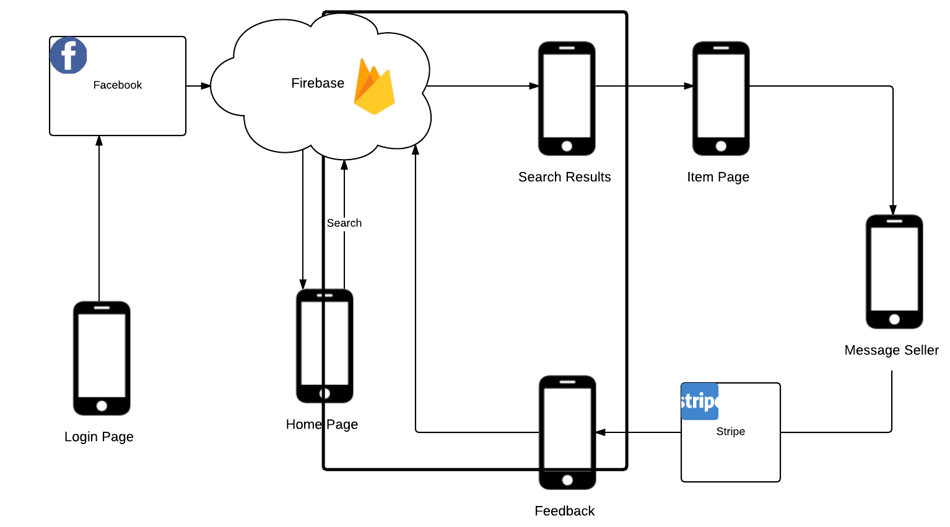
Searching for an item

Slide 33
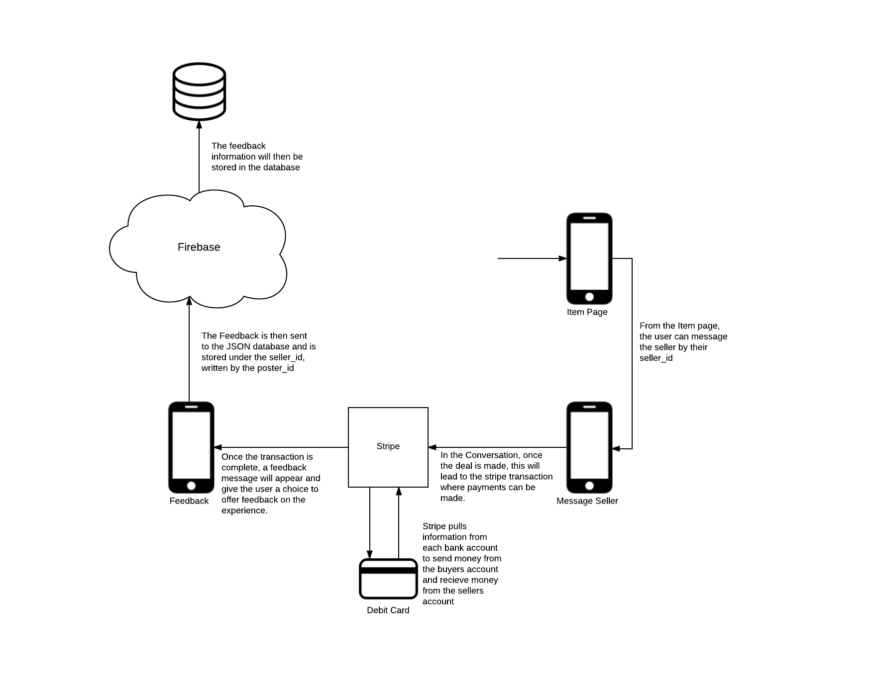
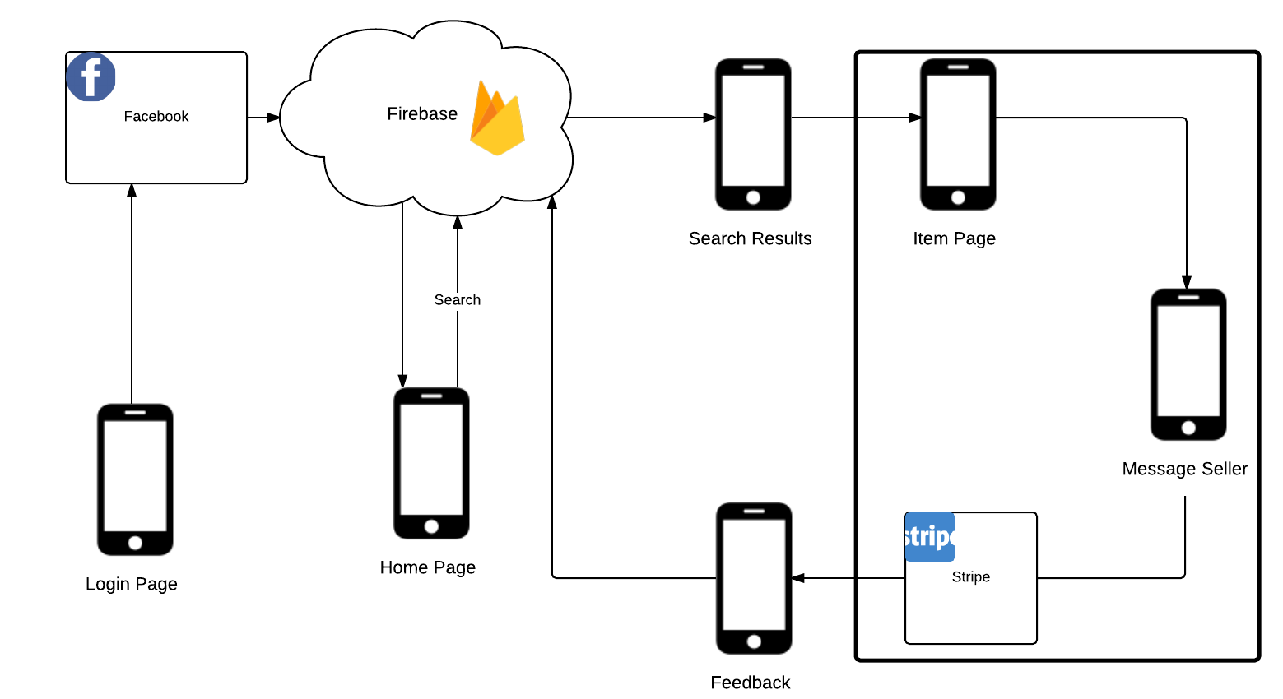
Purchase of an item

Slide 34
Time and Space Complexity
Data will be stored as a B-Tree
Storage - O(n), where n is the number of entries in each table (i.e. users, items, feedback)
Queries - O(log n), returns JSON structure

Slide 35
Questions?

